Slide 1

Sports Analytics III
Produced by Dr. Mario
UNC STOR 390

Slide 2
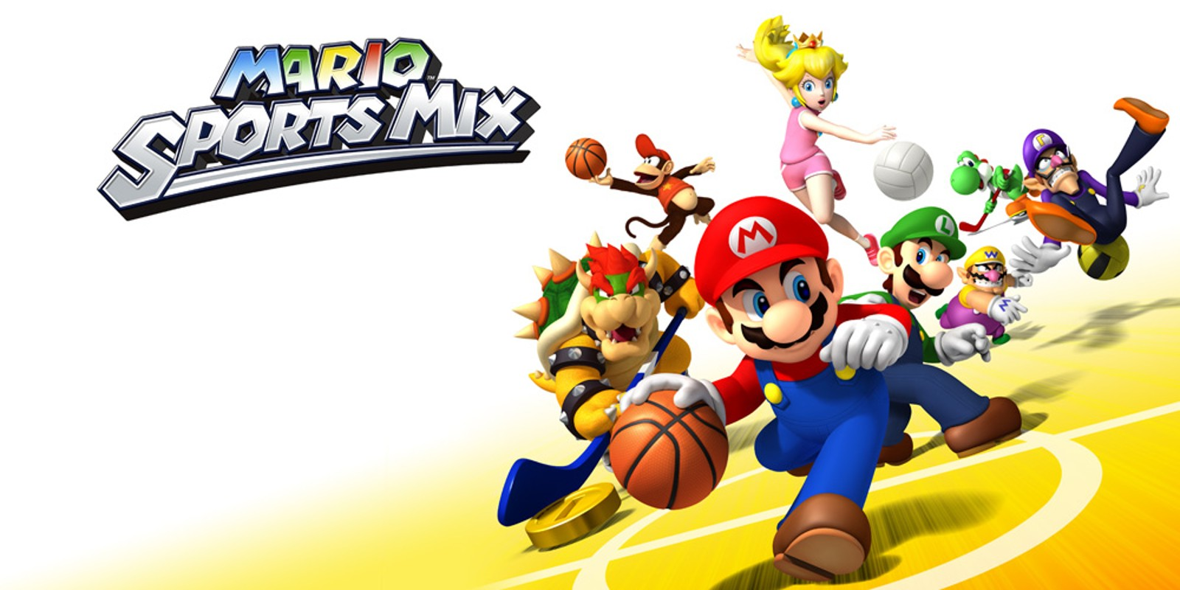
Industry Past
Sports Analytics Use Survey (2013)
Sample of 27 People (NFL, MLB, NBA, EPL)
How Many Different Sources?
1-2 (6.7%)
3-4 (33.3%)
5-6 (13.3%)
>6 (46.71%)

Slide 3
Industry Past
How Much Data is Centralized?
All (31.3%)
Most (37.4%)
Some (31.3%)
How Much Data is Dependent on One Person?
Some (50.0%)
Most (43.7%)
All Data Centralized (6.3%)

Slide 4
Industry Past
Is Data Checked for Errors?
Always (31.3%)
Usually (37.5%)
Sometimes (18.8%)
Occasionally (6.1%)
Rarely (6.3%)
How Many Database Programmers are Employed?
0 (37.5%)
1-2 (50.0%)
3-4 (0.0%)
>5 (12.5%)

Slide 5
Industry Past
How Many Statistical Analysts are Employed?
0 (20.0%)
1-2 (66.6%)
3-4 (0.0%)
>5 (13.3%)
Roadblock: Difficulty Identifying Strong Applicant
Difficulty in Both Hiring and Evaluating

Slide 6
Industry Past
Clear Process for Hiring/Evaluating Analysts
Strongly Agree (13.3%/14.3%)
Somewhat Agree (13.3%/14.3%)
Neutral (26.7%/28.6%)
Somewhat Disagree (13.4%/21.4%)
Strongly Disagree (33.3%/21.4%)
Analytic Resources in Line with Strategic Game Plan
Strongly Agree (26.7%)
Somewhat Agree (33.3%)
Neutral (33.3%)
Strongly Disagree (6.7%)

Slide 7
Industry Past
Clear Process for Hiring/Evaluating Analysts
Strongly Agree (13.3%/14.3%)
Somewhat Agree (13.3%/14.3%)
Neutral (26.7%/28.6%)
Somewhat Disagree (13.4%/21.4%)
Strongly Disagree (33.3%/21.4%)
Analytic Resources in Line with Strategic Game Plan
Strongly Agree (26.7%)
Somewhat Agree (33.3%)
Neutral (33.3%)
Strongly Disagree (6.7%)

Slide 8
Industry Present
Article by Russell Karp (ITProPortal.com)
Global Sports Market Worth $600B-$700B (KPMG)
Including All Business Dedicated to Sports $1.3T
Investment in Data Services
$764.3M
$3.07B
$125M
2014
2016
2024
Projections in 2024 According to MarketWatch.com

Slide 9
Industry Present
Modern Applications of Sports Analytics
Helping the Team Win
Automated Video Analysis (Lincoln City, UK Football)
3D Depth Camera (NBA)
Wearable Technology (NBA, NHL)
Improving the Fan Experience
Analysis of Digital Engagement
Sentiment in Social Media
Analysis of Fan Behavior in Stadium (New England Patriots)
Wireless Internet and Phone Apps
Apps Supply Game Analytics, Parking Information, Promotions, and Traffic Information to the Fans (NFL)

Slide 10
Industry Present
Modern Applications of Sports Analytics
Benefiting Other Stakeholders
Tracking Fan Behavior Outside the Stadium
Telecommunication, Retailers, Payment Providers, Ticket Agencies, and Sponsorships
Adapt to Quick Changes in Consumer Behavior
Optimizing the Back-Office
HR Practices
Game Scheduling
Supply Chain Management and Logistics
Marketing and Promotions
Procurement of Goods and Services

Slide 11
Industry Present
Modern Applications of Sports Analytics
Advancing Sports Gambling
Supreme Court Ruling Previous Statute Violated 10th Amendment (Murphy v. National Collegiate Athletic Association)
States Free to Legislate Gambling
Improvement of Gambling Products
Data Aggregation and Visualization for Bettors
Develop Daily Fantasy Sports
Worth Over $5B According to Nevada Gaming Control Board (NGCB)

Slide 12
Your Industry Future
Prerequisites by Howard Hamilton
(Soccermetrics)
Technical Skills
Mathematics (Linear Algebra/Probability Essential)
Statistics (Frequentist and Bayesian Perspectives)
Machine Learning (Supervised and Unsupervised)
Programming (R/Python, Data Structures, OOP)
Databases
Visualization
Socials Skills, Ethics, and the Law
Knowledgeable About All Aspects of the Sport

Slide 13
Your Industry Future
Real Jobs (Indeed)
Quantitative Sports Researcher for SIG
Build Statistical Forecasting Models
Implement Models and Simulate Outcomes
Demonstrated Experience with Sports Analytics Projects
Python, C++, Matlab and/or R
PhD Preferred
Analyst for the Cleveland Indians
Mission is to win a World Series (LOL)
Design New Strategies, Tools, and Tactics
Understand Statistics and Experience with Regression
Tableau, SQL, and R

Slide 14
Your Industry Future
Real Jobs (Indeed)
Part-time Faculty for Syracuse
Introductory Sports Science Analytics
Master’s with 10+ Years Industry Experience
Strategy Analyst for Skillz Inc.
Accelerate the Convergence of Sports, Video Games, & Media
Run A/B Experiments to Optimize the User Experience
Lead Analytics Projects
Honesty in Developing and Sharing Insights from User Data
Experience Using Data Visualization Platforms

Slide 15
Your Industry Future
Real Jobs (Indeed)
Sports Statistical Analyst for CBS
Synthesize Sports Data and Statistics
Understand How Stats are Used to Make Predictions
Season Long and Daily Fantasy Sports Player
Knowledge of Sports Betting and Handicapping Stats
Revenue and Forecasting Associate for FanDuel
Forecast Daily Revenue and Historical Trends
Track Live Contest Performance
Create Dashboards and Reports for Stakeholders
Regression, Cohort Analysis, Clustering, A/B Testing
Experience with SQL, Excel, R, and/or Python

Slide 16
Your Industry Future
Real Jobs (Indeed)
Quantitative Ticket Trader and Analyst for SeatSnob
Use Analytics Platform to Identify Buying Opportunities
Improve and Refine Quantitative Tools
Bachelor’s with Strong Numerical/Quantitative Skills
Strong in Excel
Knowledge of R/Python
Valuation & Analytics Intern at IPG360
Build Content Database for Quarterly Insights Report
Market and Industry Research Assistance
3.0 GPA and Strong Software Skills (Microsoft Office)

Slide 17
Your Industry Future
Real Jobs (Indeed)
Associate Data Scientist for Tokio Marine HCC
Provide Specialized Insurance Products for Sports
Disciplines: Business, Math, and IT
Tied to Actuarial Topics and Ideas
Python, R, SQL, JSON, XML, C#, Excel, and VBA
Data Visualization Technologies
Bachelor’s Degree

Slide 18
Your Industry Future
Conferences
September
Football Analytics and Performance Summit in Vienna
RIT Sports Analytics Conference in Rochester, NY
New England Symposium on Statistics in Sports in Cambridge, MA
October
Great Lakes Analytics Conference in Stevens Point, WI
Texas Sports Analytics Conference in Dallas
UConn Sports Analytics Conference in Storrs, CT
Japan Sports Analytics Conference in Tokyo
Compiled by statsheetstuffers.com and sportsanalyticsconferences.com

Slide 19
Your Industry Future
Conferences
November
Carnegie Mellon Sports Analytics Conference in Pittsburgh, PA
Ottawa Hockey Analytics at Carleton in Ottawa
Midwest Sports Analytics Meeting in Pelle, IA
United Kingdom Sports Analytics Conference in London
December
Midwest Sports Biometrics Conference in San Francisco,CA
March
MIT Sloan Sports Analytics Conference in Boston, MA
Compiled by statsheetstuffers.com and sportsanalyticsconferences.com

Slide 20
Final Inspiration
Defense wins championships.
Offense wins contracts.
Be offensive.
- Mahatma Mario

